Slide 1


FYP
Smart Cattle Health Monitoring system using IoT and AI/ML
Zunair Shahid 2422-2021
Hina Roshan 1389-2019
Supervisor: Sir Iqbal Uddin Khan
Department of Computing, FEST
Hamdard University
Version 1

Slide 2
Summary
Problem Statement
Objective
FYP Scope
Our methodology
Showcasing at NIC
FYP Deliverables
Hardware Selection
Software Tools & Technologies Used
Our Project Plan
Budget References

Slide 3
Problem Statement
Challenges in continuously monitoring cattle health parameters like temperature, heart rate and movement, along with difficulties in tracking cattle location, lead to inefficiencies in managing the herd effectively.
Supporting statement:
Livestock plays an important role in the uplift of the rural economy. It's share in the National GDP is 14.36% and it contributes 62.68% to Agricultural GDP. [1]
Traditional livestock farming methods in Pakistan are outdated and inefficient which leads issues mentioned in problem statement

Slide 4
Objective
The Objective of the Smart cattle monitoring system using IoT sensors to collect and AI/ML is to analyze, and provide understanding into cattle health, activities, ultimately improving farm management decisions and farm productivity.
“Empowering Farmers with Intelligent Cattle Care”

Slide 5
FYP Scope
The project encompasses the design, development, deployment, of a smart cattle monitoring system. This includes:
Selection and integration of sensors (Body temperature, heart rate) with microcontroller.
Integration of GPS modules and microcontroller.
Development of mobile applications (Urdu &English) for data visualization and management.

Slide 6
FYP Scope (cont’d)
Implementation of AI/ML algorithms for health monitoring and predict status of the cattle health.
Integration with cloud services for data storage and processing.
Selected number of cattle and selected number of attributes.

Slide 7
Our Methodology
Water Fall Approach:
The Waterfall approach will be used for the Smart Cattle Monitoring System. This methodology is ideal for this project because the requirements and outcomes are already well-defined and understood. Using the Waterfall approach ensures a structured and sequential development process, allowing each phase to be completed before moving on to the next.

Slide 8
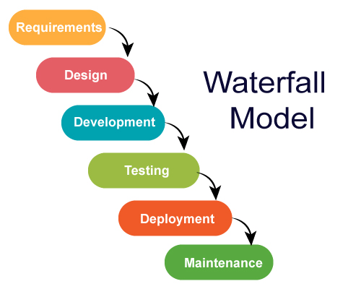
Our Methodology (cont’d)

Slide 9
Showcasing at NIC – National Incubation Center (Cohort 13)
We had the amazing opportunity to present our FYP at NIC as part of Cohort 13.
Out of 625 startups that applied, only 125 were shortlisted, and we were proud to be one of them.
The experience gave us a chance to connect with industry mentors, receive real feedback, and see our idea through a startup lens.

Slide 10
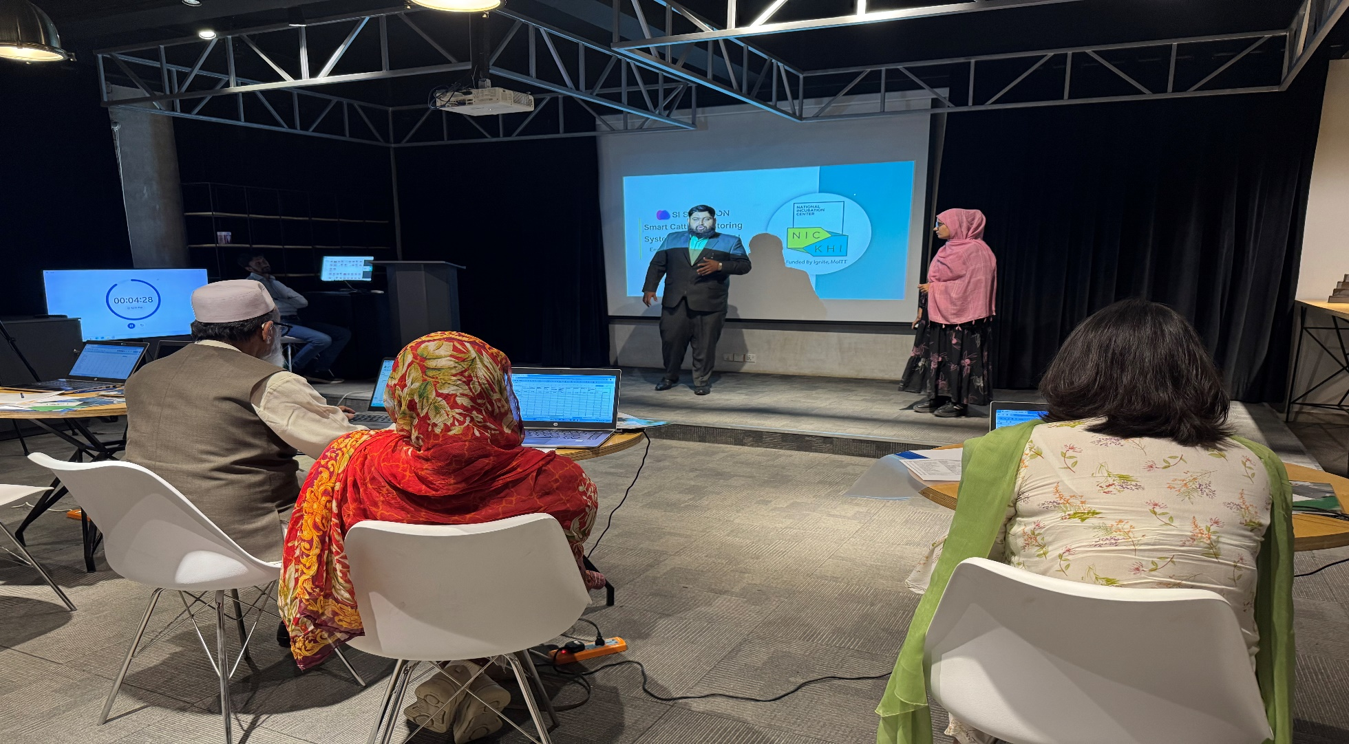
Showcasing at NIC – National Incubation Center (Cohort 13)

Slide 11
FYP Deliverables
First Evaluation
Hardware Development (IoT)
Configuration of Cloud Platform
Integration of Hardware with Cloud Platform.
Final Evaluation
ML model development for cattle health prediction.
Mobile App Development (Urdu + English interface).

Slide 12
FYP Deliverables (cont’d)
Integration of ML model with cloud platform.
Initial data collection and system monitoring
Initial data analysis on animal health Prediction

Slide 13
Hardware Selection:
Market Survey & Discussion with FYP Supervisor: Concluded that Raspberry Pi is cost-heavy.
Alternative Chosen: ESP32.
Reasons for Selection:
Low power consumption.
Built-in Bluetooth & Wi-Fi support.
Cost-effective, making it more feasible for adoption

Slide 14
Hardware Selection:
Microcontroller: Arduino
Sensors Used:
Heart Rate Sensor – For monitoring cattle heart rate.
DS18B20 Temperature Sensor – For body temperature measurement.
ADXL345 Accelerometer – For movement and activity tracking.
NEO-6M v2 GPS Module – For location tracking.
HC-12 Bluetooth Module – For wireless communication.

Slide 15
Software Tools & Technologies Used
Cloud Platform: Firebase Real time Database
Used for real-time storage and retrieval of sensor data.
Chosen due to:
Real-time syncing
Easy integration with Flutter
Free tier

Slide 16
Software Tools & Technologies Used
Machine Learning: Python (scikit-learn)
Developed a Logistic Regression model for cattle health prediction.
Trained on local machine using real collected data.

Slide 17
Software Tools & Technologies Used
Model Deployment: Flask + ngrok
ML model hosted using Flask (Python web framework).
Exposed locally running API using ngrok for public access.
Ensured real-time integration with Firebase data.

Slide 18
Software Tools & Technologies Used
Testing Tool: Postman
Used to test API endpoints and validate ML model predictions.
Simulated real-time data submission from sensors.

Slide 19
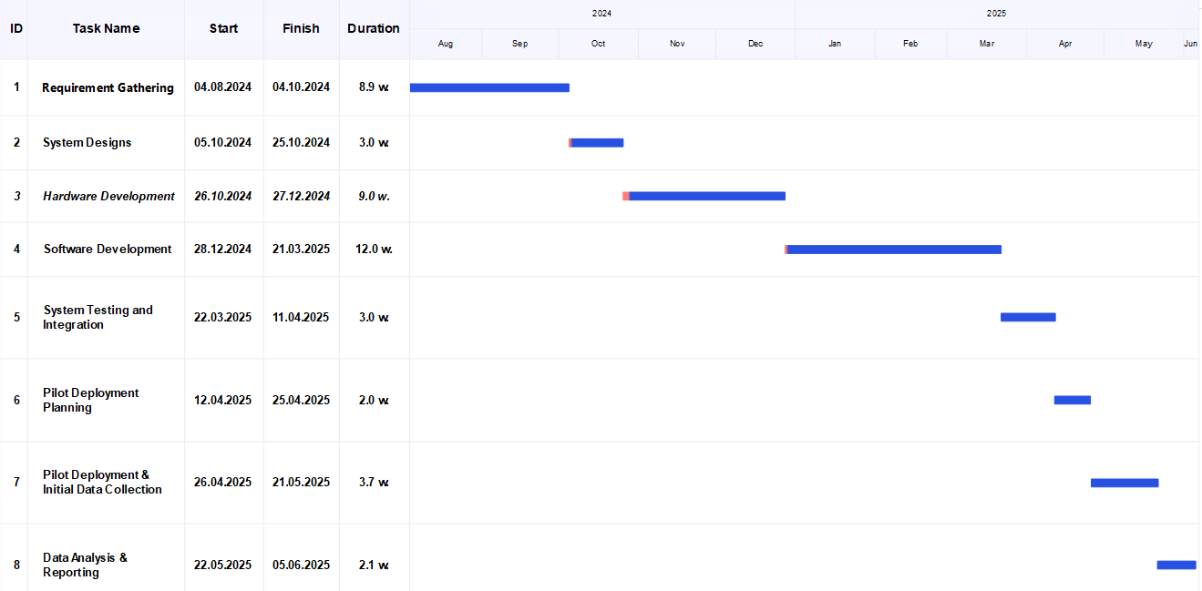
Our Project Plan

Slide 20
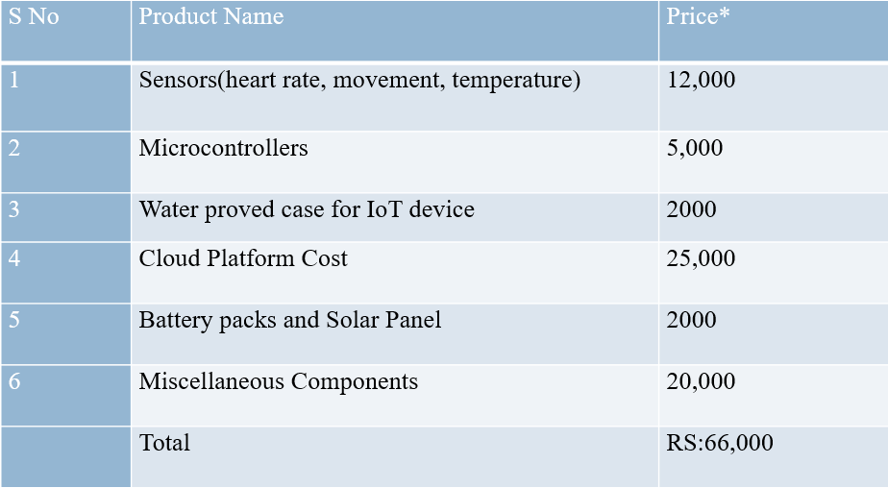
Budget / Costing

Slide 21
Reference
[1] Punjab Livestock & Dairy Development Department, "Livestock Contribution," [Online]. Available: https://livestock.punjab.gov.pk/livestock-contribution.

